Slide 2
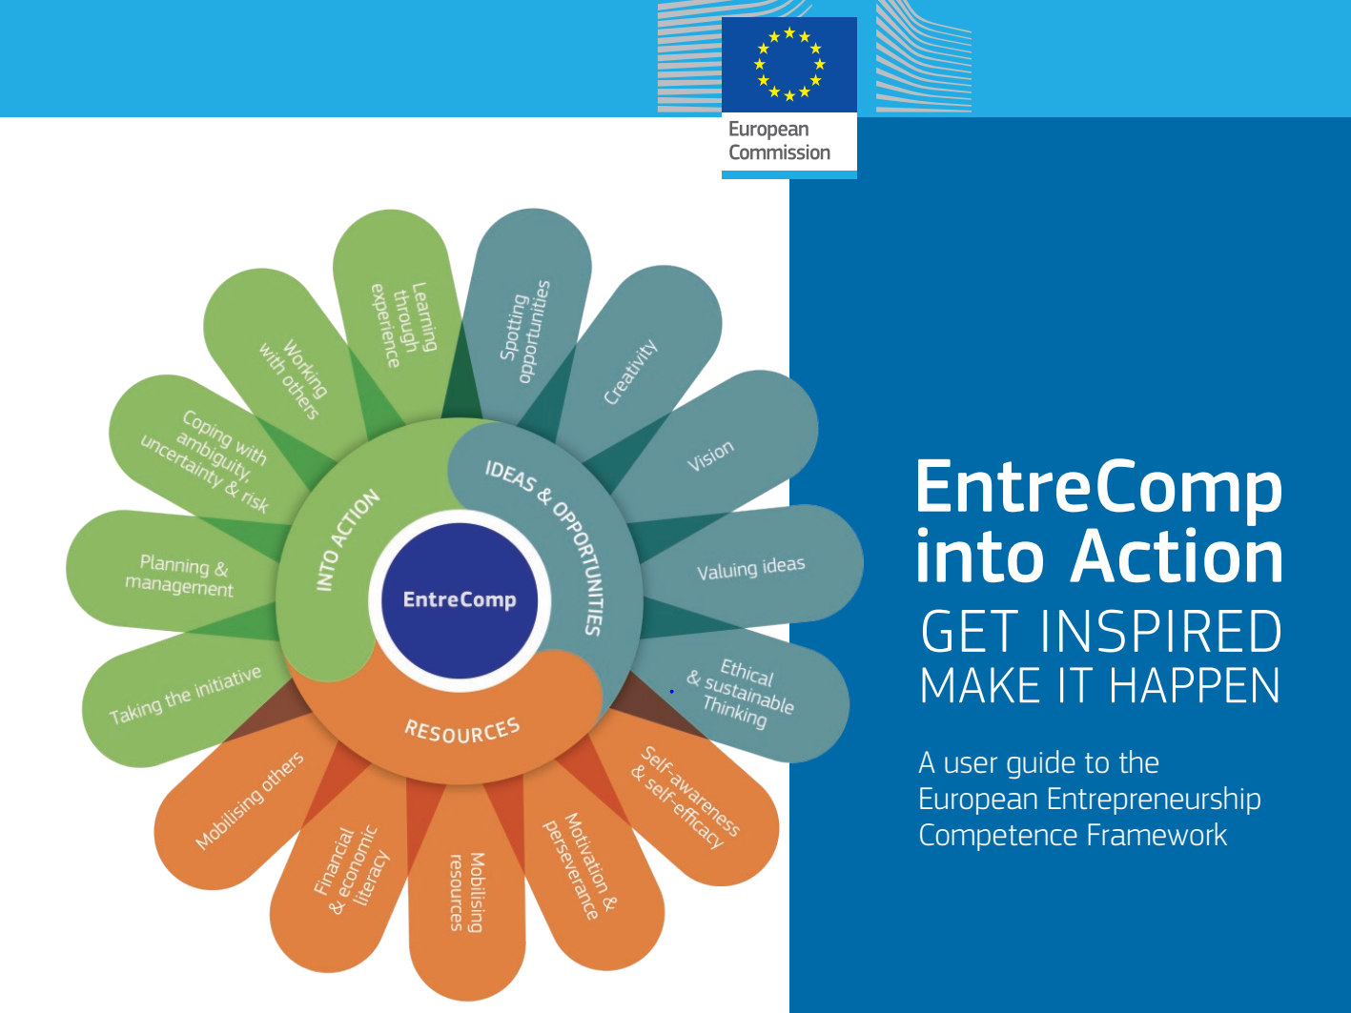
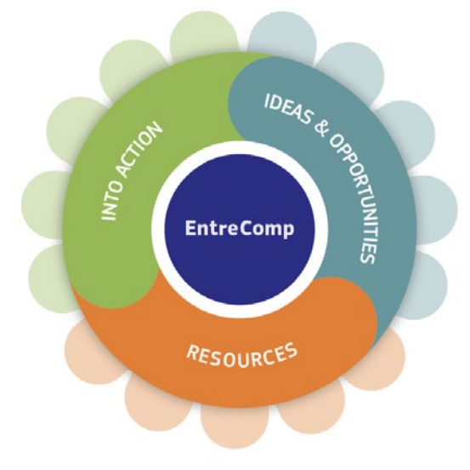

Slide 3
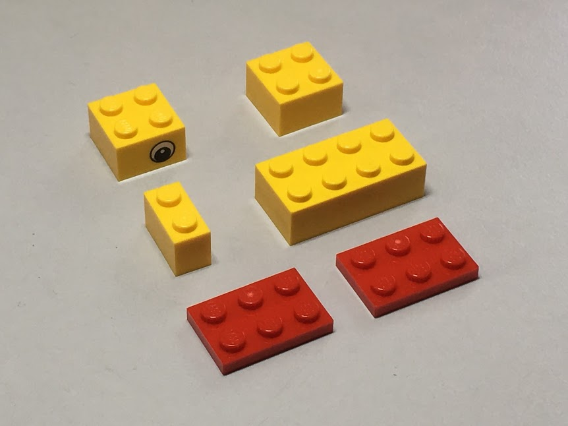
Build your own duck
By just looking at only these 6 LEGO pieces,
can you build a duck?
Inspired by @LSBU’s @SafiaBarikzai

Slide 4
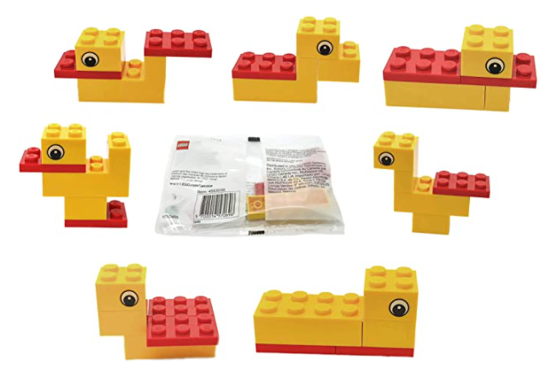
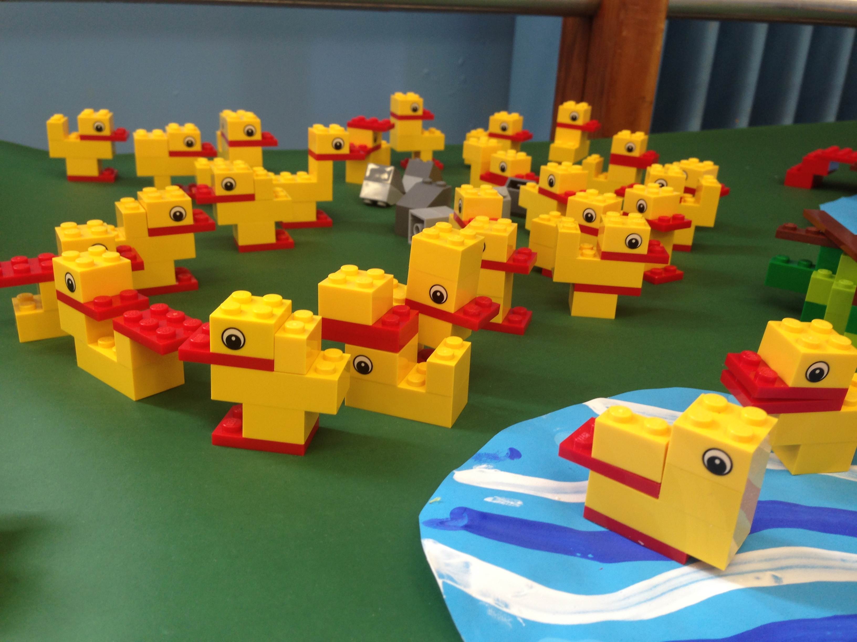
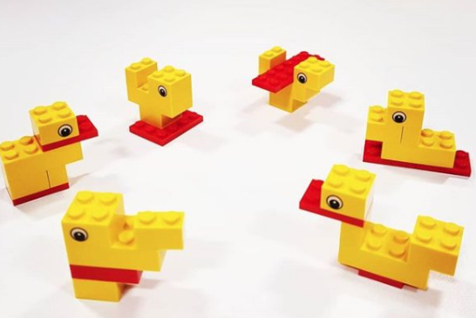
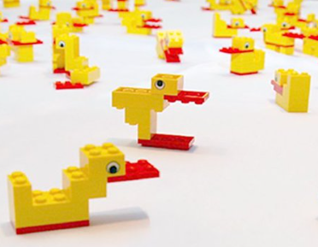
2
3
1
5
18
19
4
7
17
6
21
Is your duck here?
20
13
15
11
9
10
14
12
16
8

Slide 5
2
3
1
5
18
19
4
21 (example) duck options...
7
17
6
21
Is your duck here?
20
13
15
11
9
14
10
12
16
8

Slide 6
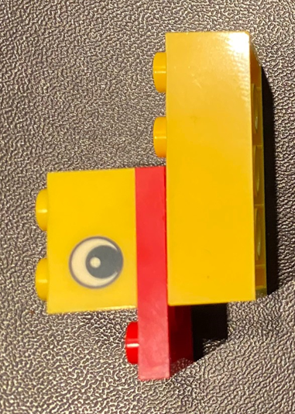
Discuss together your approach/process and the results
What was your inspiration
  How to start? When to finish?
  Customer needs
What was the team/your approach?
  Agreed approach? Prototyping / Testing?
  Adapt or amend? Straight to task or plan?
Use all available resources?
  When is it “enough” or ok?
What feedback do you need?
When?

Slide 7
Reflection (and future actions for next time!)
Reviewing your experience / approach / activity
Did you/ your team deliver?
  Meet the brief/ address the customer need / is it fit for purpose?
What did you learn from this?
  Are you creative? How many solutions are “right”?
What would you do differently?
  What can you take away and remember for any future creative challenge/task?

Slide 8
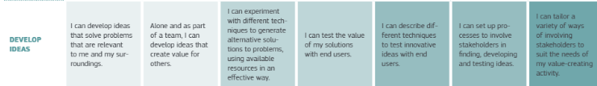
EntreComp Reflection
EntreComp Competence statements: Develop Ideas
Foundation
  I can develop ideas that solve problems that are relevant to me and my surroundings
  Alone, and as part of a team, I can develop ideas that create values for others.
Intermediate
  I can experience with different technique to generative alternative solutions to problems, using available resources in an effective way
  I can test the value of my solutions with end users

Slide 9
Thank you
alison@enterprise.ac.uk

