Slide 1
Turning Entrepreneurship Competence into Credit
HOTIT OPIT -project

Slide 2
Yoop.fi
The tool aims to help the students and the teachers to identify and articulate entrepreneurship competences and to familiarize the users with recognition and accreditation of learning through examples and guidelines.

Slide 3
Yoop.fi in a nut shell
Intuitive user interface, no sign-up needed, scalable to different devices
Self assessment of entrepreneuriship competences
Students’ stories
Definitions of recognition and accreditation of learning
Recommendations and case studies for the teachers
Raises awareness of recognition and accreditation of learning.
Helps the students to identify and to articulate their entrepreneurship competences.
Offers models for applying recognition and accreditation of learning in entrepreneurship studies for students and teachers.

Slide 4
For students

Slide 5
Basic information about recognition and accreditation of learning

Slide 6
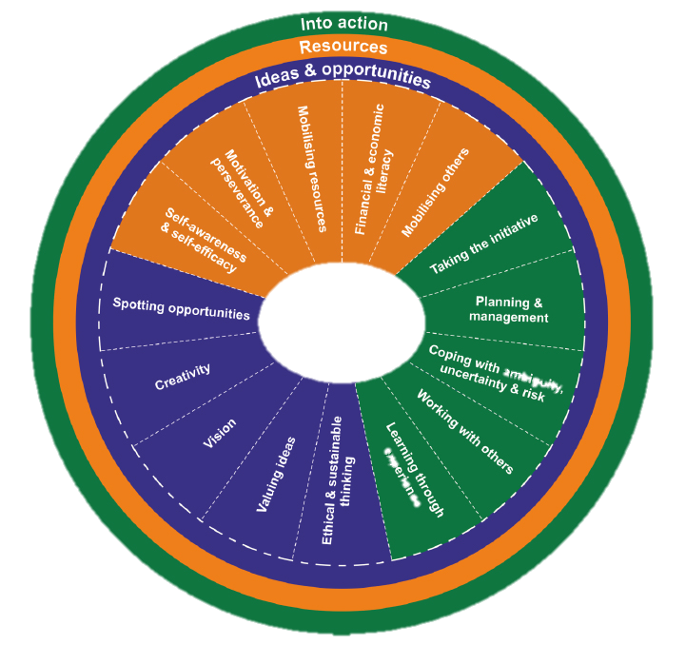
Self assessment of entrepreneurship competence (1/3)
Based on EntreComp - Entrepreneurship Competence Framework developed in the EU:
Elements:
Spotting opportunities
Creativity
Vision
Valuing ideas
Ethical and sustainable thinking
Self-awareness and self-efficacy
Motivation and perseverance
Mobilising resources
Financial and economic literacy
Mobilising others
Taking the initiative
Planning and management
Coping with uncertainty, ambiguity and risk
Working with others
Learning through experience

Slide 7
Self assessment of entrepreneurship competence (2/3)
For example:
There are from 2 to 3 statements in each section.
Self assessment helps the student to recognize the existing entrepreneurship competence in each section.
The student is requested to describe the activities in which he/she has gained the respective entrepreneurship competence.
For example
what has (s)he done,
what has (s)he taken part in, or
what and how has (s)he learned.

Slide 8
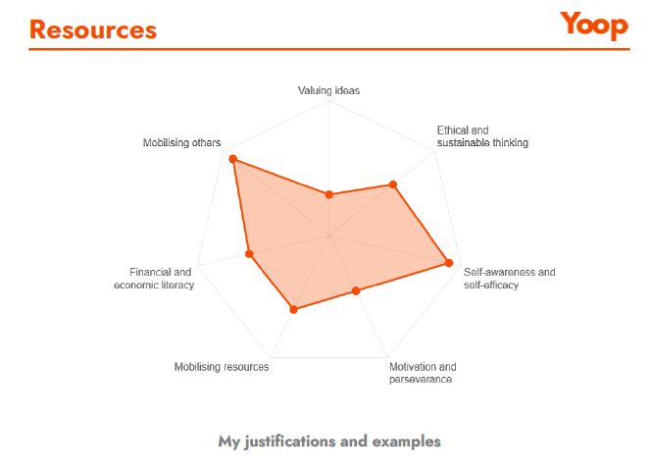
Self assessment of entrepreneurship competence (3/3)
For example:
An outcome of the report is a printable report, which can be utilised when preparing for the recognition and accreditation of learning.
The report is not to be taken as an exact description of competence or the level of competence.
Rather, it is a helpful tool for the student to recognise and articulate the competence in general terms.

Slide 9
Students’ stories
Available also on YouTube @ YoopTUBE

Slide 10
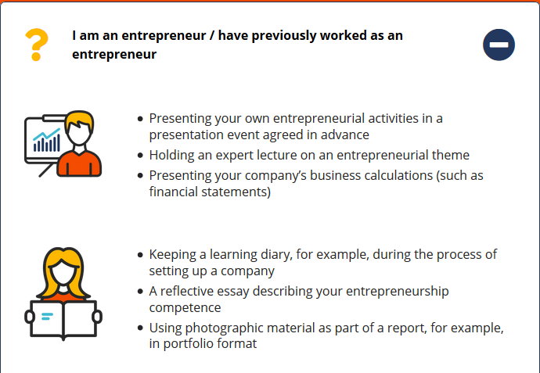
Tips for demonstrating competence

Slide 11
For teachers and developers of education

Slide 12
Teacher’s section includes
Course, subject and university level recommendations together with matching case studies
A report of a study on which Yoop.fi is based

Slide 13
Recommendations (R1-R5)
Recommendations based on the interviews, good practices and literature are divided into five themes:
practices, responsibilities and principles at the level of higher education
methods and processes for the assessment of entrepreneurship competence
implementation of the practices
cooperation with third parties
information and communication.

Slide 14
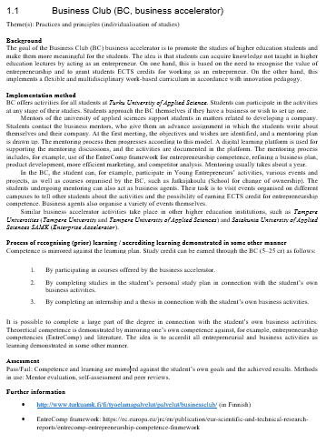
Case studies
The report includes 12 case studies, which offer solutions to the identified challenges.
Descriptions are targeted to teachers to inspire them when designing the studies and implementing the practices related to RPL and accreditation of learning demonstrated in some other manner.
Case studies are linked to the themes of the recommendations
The structure of the case studies is consistent which makes them easy to utilise:
Background
Implementation method
Process of recognition and accreditation of learning
Assessment
Further information.

