Slide 1
Enterprise Education
Building confidence

Slide 2
What is the definition of Enterprise Education?
The use of practical situations to develop skills that can be applied across both education and professional life

Slide 3
What is the Value of Enterprise Education?
Develop behaviours, mind-set and competencies with the overall aim of increasing employability
Preparing for the dynamic and challenging environment of the workplace
Putting academic knowledge into practice in the workplace
Ensuring a professional working life whether employed or self-employed

Slide 4
Learning Outcomes
To be able to recognise relevant information and describe them
To communicate concisely, confidently and effectively
Confidence

Slide 5
The Professional Speed-date
Notes:
Example of “sexified” version of the ppt
Illustration source: https://www.seattletimes.com/life/lifestyle/speed-dating-in-the-age-of-swiping-the-irl-dating-trend-is-still-ringing-bells/

Slide 6
My area of expertise is...

Slide 7
My biggest accomplishment is…

Slide 8
The biggest challenge I have face so far is....

Slide 9
Right after uni, I want to...

Slide 10
In my career, I want to achieve...

Slide 11
To achieve my goals, I am currently...

Slide 12
Reflect & Discuss
Think about:
What were the challenging parts?
How did you overcome them?
How quickly did you overcome them? How did you feel at the beginning compared to at the end?

Slide 13
Just A Minute!

Slide 14
Feedback
Notes:
Instructor’s feedback to the class on how they’ve done.

Slide 15
How is Enterprise Education Included in your course?

Slide 16
Your review/feedback on Enterprise Education

Slide 17
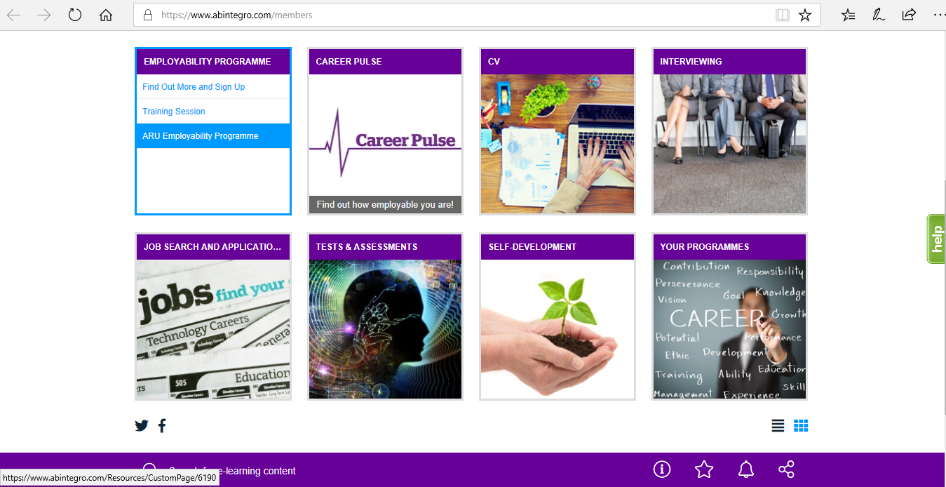
Employability and Careers Portal
https://www.abintegro.com/Resources/elearning/Hub.aspx

Slide 18
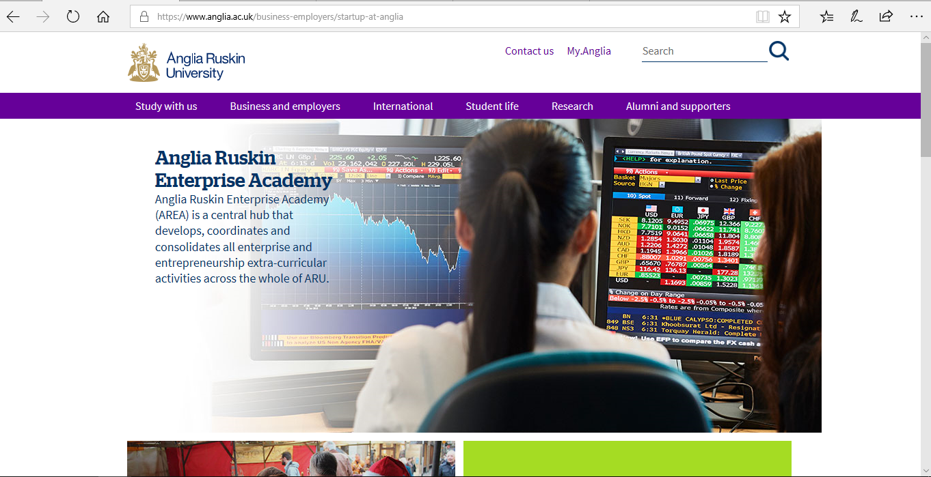
Anglia Ruskin Enterprise Academy (AREA)
https://www.anglia.ac.uk/business-employers/startup-at-anglia

