Slide 1


Enterprise Education
How Does it Help in Shaping my Future?

Slide 2
What is the Definition of Enterprise Education?
The use of practical situations to develop skills that can be applied across both education and professional life
Notes:
What do students understand by Enterprise Education? Ask for contribution from students before displaying the definition

Slide 3
What is the Value of Enterprise Education?
Develop behaviours, mind-set and competencies with the overall aim of increasing employability
Preparing for the dynamic and challenging environment of the workplace
Putting academic knowledge into practice in the workplace
Ensuring a professional working life whether employed or self-employed

Slide 4
What are Enterprising Skills?
ORIGINALITY
ADAPTABILITY
INNOVATION
NETWORKING
INITIATIVE
PROBLEM IDENTIFICATION
COMMUNICATION
PERSONAL EFFECTIVENESS
DESIGN THINKING
PROBLEM SOLVING
EXPRESSION
IDENTIFYING OPPORTUNITIES
TIME KEEPING
PRACTICAL ACTION
CONDUCT
DECISION MAKING

Slide 5
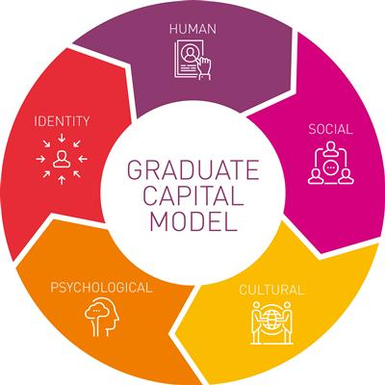
Notes:
Enterprising skills link to the Graduate Capitals in developing skills in a number of the different areas

Slide 6
What is Employability?
“A set of achievements – skills, understandings and personal attributes, that make individuals more likely to gain employment and be successful in their chosen occupations, which benefits themselves, the workforce, the community and the economy”
(Knight and Yorke, 2003)
Notes:
What do students understand by Employability? Ask for contribution from students before displaying the definition

Slide 7
Activity

Slide 8
Session Review
What particular ‘Enterprising’ skills do you feel you have developed through this session?
Why do you feel that Enterprise Education is important?
Can you identify ways in which Enterprise Education is already included in your modules?
Can you identify ‘Enterprising’ skills you have already developed from your modules?
Notes:
Skills - Refer back to skills identified on slide 4 – can students identify any others?
Why is Enterprise Education important? – to make students more “employable”, to make students stand out from others with the same qualifications, importance of being able to articulate these skills to potential future employers
Ways in which Enterprise Education is already included – group work sessions, presentations, engagement with employers
Development of Enterprising skills- e.g. group presentations – communication, team work, problem solving

Slide 9
Where can I Find Out More?
Enterprise Education Student Guide
Anglia Ruskin Enterprise Academy (AREA):
ARU Career Centre:
  employability@anglia.ac.uk
Anglia Ruskin Enterprise Academy (AREA):
  Marcia Baldry-Bryan (Enterprise and Entrepreneurship Support Manager)
    marcia.baldry@anglia.ac.uk
    Imrana Begum (Enterprise & Entrepreneurship Administrator)
    imrana.begum@anglia.ac.uk
    https://aru.ac.uk/student-life/opportunities-at-aru/startup-at-anglia
Notes:
ARU Career centre – employability support, online resources and drop-in sessions, career pulse self-assessment tool, Personal Career Development plan
AREA- co-ordinate all Enterprise and Entrepreneurship activities across the university, support to improve essential skills, extra-curricular activities e.g. Be Your Own Boss and the Big Pitch

Slide 10
Any Questions?

