Slide 1
Lauren Davies Lecturer in Enterprise and Entrepreneurship
Dr Tilly Line
Senior Enterprise Consultant
Exploring the Impact of Socially Driven Projects in Developing Students’ Enterprise Skills
5th September 2019

Slide 2
Outline
EERPF funded project
Exploring motivations and skills development of students engaging in socially driven projects
Project initiated within professional services role
Driven by evidence of increased interest in socially-driven projects
Today we will cover:
Aims of the Research
Methodology
Quantitative Analysis
Qualitative Analysis
Limitations and Future Research
Discussion

Slide 3
Aims of the Research
Are there significant differences in the enterprise skills development of students engaging in entrepreneurship education compared to those engaging in socially-driven projects?
Are there significant differences in the motivations of students engaging in entrepreneurship education compared to those engaging in socially-driven projects?
What can be learnt about the language used by students, in the context of social enterprise, that could be utilised when attempting to engage others in enterprise education and socially-driven projects?

Slide 4
Methodology
Pre and post skills audit using Likert scales in relation to the Entrepreneurial Competencies in the QAA Guidelines (2018) for students on the Enterprise Scholarship Scheme
Online questionnaire to targeted groups of students
Focus groups with selected students that completed the questionnaire

Slide 5
Skills Audit Results
Male | 18
Female | 15
Faculty of Arts, Creative Industries and Education | 7
Faculty of Business & Law | 7
Faculty of Environment & Technology | 11
Faculty of Health & Applied Sciences | 8
Start Up Scholarship | 21
Impact & Innovation Scholarship | 12

Slide 6
Skills Audit Results
For students on the Start Up Scholarship – the biggest increase in (perceived) skill level was pitching ideas, followed by resource management
The skill with the lowest (perceived) increase was creativity and problem solving
For students on the Impact & Innovation Scholarship the biggest increase in (perceived) skill level was pitching ideas, followed by recognising and creating opportunities
The skill with the lowest (perceived) increase was again creativity and problem solving – perhaps owing to the large proportion of students from the Arts and Creative Industries Faculty (perceived levels of creativity were higher to begin with)
Overall the average increase in (perceived) enterprise skills was higher for students on the Start Up Scholarship than the Impact & Innovation Scholarship (though the results were not statistically significant)

Slide 7
Survey Results
Male | 10
Female | 14
18-25 yrs | 15
26-35 yrs | 5
36+ yrs | 4
1st year | 5
2nd year | 4
Final year | 14

Slide 8
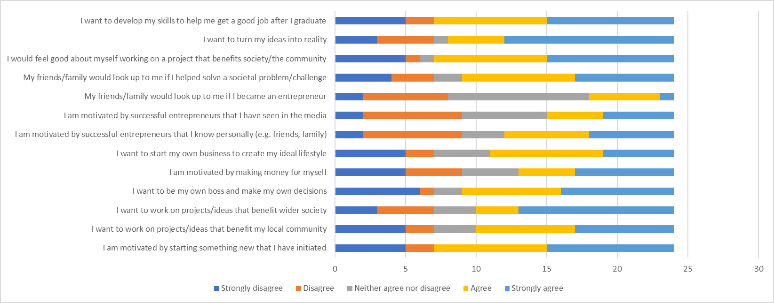
Survey results
Thinking about your motivation for participating in the activity/activities indicated above please rank how strongly you agree/disagree with the following statements
→ Least motivating

Slide 9
Survey results
Thinking about your motivation for participating in the activity/activities indicated above please rank how strongly you agree/disagree with the following statements
→ Most motivating → Both strongly agree and agree

Slide 10
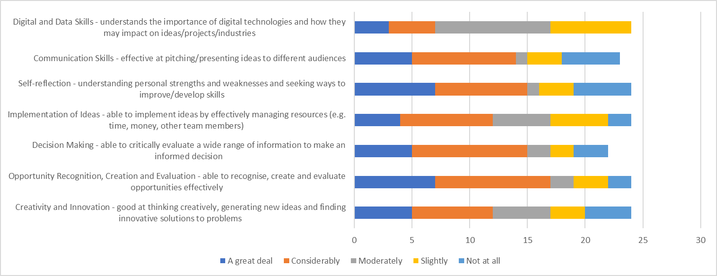
Survey results
Thinking about the activities you ticked above, please rank the extent to which your participation directly contributed to your development of the following skills
→ Biggest increase

Slide 11
Survey results
Thinking about the activities you ticked above, please rank the extent to which your participation directly contributed to your development of the following skills
→ Smallest increase

Slide 12
Focus Groups
Two focus were undertaken with five survey respondents
Each focus group lasted an hour and further explored the participants’ motivations for taking part in enterprise activity and the skills they developed as a result
Three out of the five participants have undertaken activity relating to social enterprise, two pursued commercial ventures
All participants are referred to using pseudonyms
Overall the participants did not necessarily have anything to add to their original answers.
Despite being asked directly to consider a particular motivation, the participants veered back to those that were most relevant, or potentially, the ones they were most consciously aware of. As such, only the following motivations were considered in detail.

Slide 13
Focus Group Findings
Key Enablers for participant engagement in enterprise
Scholarships – i.e. money! (3 participants)
“Desk space” (1 participant)
A mentor (2 participants)
UWE Enterprise workshops
Phillippe (international PhD student) has a business based in his home country. For him, the support available provided guidance on establishing his business in the UK market.
Rose, a mature student with many years of business experience still appreciated the opportunity to gain new up-to-date information on legislation, regulations, licences and new ways in which companies are recruiting.
Notes:
Two out of the five participants explained that the Enterprise Scholarships – constituting £1,000, desk space, a mentor and UWE Enterprise Team over eight weeks of the summer vacation - was the catalyst to starting their business. Similarly, one attendee was able to push their business forward using an award of £500 and the opportunity to gain a mentor through the UWE Summer Scholarships, and another explained that they “…decided to work on the Start-up Scholarship programme to kick-start my own business”.
Workshops delivered by the UWE Enterprise team were also highlighted by three members of the focus groups as being particularly useful in developing their business skills. Phillippe is an international PhD student with a business based in his home country. For him, the support available provided guidance on establishing his business in the UK market. Rose, a mature student with many years of business experience still appreciated the opportunity to gain new up-to-date information on legislation, regulations, licences and new ways in which companies are recruiting. Interestingly these participants had established businesses, illustrating that support for students is not necessarily for those for whom enterprise and entrepreneurship is an unknown, or for those at the beginning of their business journey.
Two participants were confused as to why the UWE workshops were not more popular, including Sophie, a mature Creative Arts student, who also suggested that peer-peer endorsement of the support available might help to engage new students,
“…when I start talking to my cohort about it… I say, 'Wow, look at this, I've been given £1,000 and a mentor.' And they go, 'Oh, right.' And they apply for it. I think there are so many messages and so many emails, and if you want to read them you will. But other than that I think it's got to be some personal communication.”

Slide 14
Focus Group Findings
Motivation: Benefiting community – all participants
Sophie creates and sells sculptures and actively uses her business to give people from a wide range of incomes “an entry point” to this particular market
She would also like to contribute to the public discourse relating to the use of art as a method of healing trauma,
“I've used art for my own healing. So, part of what I want to do is take this conversation into society and how we talk about art, and how we can use connection to our own feelings”
Notes:
All of the participants referred to the chance to benefit their community as a motivation for taking part in enterprise activity, but in very different ways. For example, Sophie creates and sells sculptures and actively uses her business to give people from a wide range of incomes “an entry point” to this particular market, unlike galleries who add a large commission. Further, Sophie would like to use her business to contribute to the public discourse relating to the use of art as a method of healing trauma,
“I've used art for my own healing. So, part of what I want to do is take this conversation into society and how we talk about art, and how we can use connection to our own feelings”

Slide 15
Focus Group Findings
Motivation: Benefiting community – all participants
Rose also referred to supporting the Arts, by providing young artists with secure part time work,
“… But this gives them a job, an income, and something that they can trust, and also not compromise what they really want to do, and what they're passion is, and I think that's important.”
Similarly Emma, a commercial business owner, wanted to use enterprise to “…promote local businesses, like local artists, people that make their own food, their own teas and coffees.”
Notes:
Rose also referred to supporting the Arts, by providing young artists with secure part time work,
“…it could be somebody who is just starting out in art, you know, a youngster, and they can't afford to do it full-time. But this gives them a job, an income, and something that they can trust, and also not compromise what they really want to do, and what they're passion is, and I think that's important. A lot of them don't get that opportunity, they have to work.”
Similarly Emma, a commercial business owner, wanted to use enterprise to “…promote local businesses, like local artists, people that make their own food, their own teas and coffees.”

Slide 16
Focus Group Findings
Motivation: Benefiting community – all participants
Phillippe was also motivated to support his community, in this case in his home country,
“I was able to go to university, but the people that were around, …They live on less than $2 a day. It was like, 'Okay, I have to do something that can integrate different farmers and different stakeholders so we can produce something together”
Here Phillippe points to social conscience as a catalyst for starting his business - Emma (commercial business owner) and Ben (participant in various UWE Enterprise activities) - talked about this also being a motivating factor for the market to engage in their products…
Notes:
Pedro was also motivated to support his community, in this case in his home country,
“I was able to go to university, but the people that were around, they don't even have the money to go to high school or anything. They live on less than $2 a day. It was like, 'Okay, I have to do something that can integrate different farmers and different stakeholders so we can produce something together,' so that was my motivation”
Here Pedro points to social conscience as a catalyst for starting his business, whereas Emma and Ben – a participant in various UWE Enteprise activities - talked about this also being a motivating factor for the market to engage in their products,

Slide 17
Focus Group Findings
“Emma: …This massive social conscience thing that's being pushed forward at the moment …to do that, you can start really locally, and people can go in and do something as simple as buying a coffee from somebody around them, and feel like they've made an impact on their day.
Ben: People want to feel positive about what they do. It's like a social behaviour of, 'I'm better because I'm doing this.'
Emma: Social status, yes.
Ben: Exactly, and brands are getting pulled by that right now. Even if you don't want to make money by doing that, you will make it”
Notes:
“Emma: …This massive social conscience thing that's being pushed forward at the moment about being green, and being healthy, and being alternative, and saving the world. In order to do that, you can start really locally, and people can go in and do something as simple as buying a coffee from somebody around them, and feel like they've made an impact on their day. …Money and local community development go hand in hand at the moment, especially in places like Bristol.
Ben: People want to feel positive about what they do. It's like a social behaviour of, 'I'm better because I'm doing this.'
Female: Social status, yes.
Male: Exactly, and brands are getting pulled by that right now. Even if you don't want to make money by doing that, you will make it, because I was reading something I studied. Some people, even if the product doesn't taste better than the other one, because you have a claim that says that it's social conscious and blah, blah, blah, you get more attraction to it.”

Slide 18
Focus Group Findings
Motivation: Be your own boss
Overall, the participants were not motivated to get involved in enterprising activity in order to ‘be their own boss’,
Emma explained that, although being an entrepreneur has provided her with “the freedom to make my own decisions”, she did not like the idea of “being in charge”.
Phillippe said “knowing what changes you have to make for your business, what sacrifices you have to make… those weigh quite heavily on a person as well. …It’s a tough path.”
Notes:
Overall, the participants were not motivated to get involved in enterprising activity in order to ‘be their own boss’. , Emma explained that, although being an entrepreneur has provided her with “the freedom to make my own decisions”, she did not like the idea of “being in charge”. Similarly, Pedro spoke of the pressure of making the right decisions; that “knowing what changes you have to make for your business, what sacrifices you have to make… those weigh quite heavily on a person as well. I think, yes, you want to be your own boss. …It’s a tough path.”

Slide 19
Focus Group Findings
Motivation: Be your own boss
More positively Sophie referred to the creative freedom the business has provided her, something that she feels is compromised when she works for someone else,
“…I've got a very expansive way of thinking, and when I get told, 'You have to do this this way,' … it comes to a point where I can't stand it. I have to be able to engage my unusual way of thinking …it doesn't fit into some predesigned box. It's only really going to work well for me if I can have a large degree of freedom.”
Notes:
In contrast however, Sophie referred to the creative freedom her business has provided her, something that she feels is compromised when she works for someone else,
“…I've got a very expansive way of thinking, and when I get told, 'You have to do this this way,' … it comes to a point where I can't stand it. I have to be able to engage my unusual way of thinking …it doesn't fit into some predesigned box. It's only really going to work well for me if I can have a large degree of freedom.”

Slide 20
Focus Group Findings
Motivation: Friends and/or family “looking up to me as an entrepreneur”
Not a direct motivation, but Sophie and Rose described how their experience of enterprise has allowed them to positively influence others,
“No, I don't want people to look up to me, but I am interested in leadership, in a way, of saying, 'Look, this is possible.‘” (Rose)
“…it's also to encourage the youngsters in the family, to say you have choices …that not to be worried if they come up with a great idea or a good business, see it through, and see if it will work. Don't just dismiss it and think it'll be too hard.” (Sophie)
Notes:
The participants were asked whether their friends and family were a motivating factor, with respect to their opinion of them as an entrepreneur or as someone ‘solving a social problem’. None of the participants felt this had influenced them directly, but Sophie and Rose described how their experience with enterprise has allowed them to positively influence others,
No, I don't want people to look up to me, but I am interested in leadership, in a way, of saying, 'Look, this is possible.' I hate it when you want to find something or you want to resolve something but you don't know what to do, and so, if I find someone in that situation, I can say, look, here's an idea, or, let's think about this” (Rose)
“I'm not motivated to impress my family, but they will be impressed anyway. It's that sort of thing, but, it's also to encourage the youngsters in the family, to say you have choices …that not to be worried if they come up with a great idea or a good business, see it through, and see if it will work. Don't just dismiss it and think it'll be too hard. I think its setting examples as well. That's more important to me, to show what can be done.” (Sophie)

Slide 21
Key conclusions
Despite more students indicating that the opportunity to ‘start something new that I have initiated’ was a motivator in the questionnaire, this did not come through in the focus groups
Highlights difficulty in selecting the ‘right’ language in quantitative data selection
We need to create a language around Enterprise/Social Enterprise that engages people at different stages of their journey. It’s not just about engaging people who’ve never thought about social enterprise, but also those further down the path
Although overall motivations to take part in enterprise activity differ, there is some commonality, particularly around a desire to benefit community or wider society. Other motivations were also clearly articulated, and by more than one participant, therefore reference to them may motivate or engage others to take part for similar reasons

Slide 22
Focus Group Findings
Skill: Confidence building
While we did not ask students to consider “confidence” as a skill, this emerged when discussing other skills
For example, students spoke about confidence in terms of pitching and having the confidence to make decisions
“But it's also a confidence thing I think, decision making. Like, when you're dealing with something that's new, or something you personally don't understand that well, or you're still learning about. It can be very difficult to know what decision to make.” (Emma)
Confidence building also emerged in terms of feeling that the activities allowed a ‘safe place to fail’ and gave students confidence in what they could achieve
“I think something that has been valuable has been each point that I've engaged with something with enterprise, it's looked to be before I've done it as something just beyond what I'm comfortable going for. Each thing I applied for I thought that looks interesting, but it's more than I could do, then I'd applied and thought, 'Oh, I can do that.' Also it's been held and contained, so although it was scary to apply to the Dragon's Den, it's been well held. So, there wasn't any greatest risk, I could try it and it was a safe space.” (Sophie)

Slide 23
Focus Group Findings
Skill: Implementation/Business Knowledge
Several of the students mentioned that the activities helped to develop their skills in implementing their ideas and/or their practical business knowledge and skills
In the online questionnaire digital and data skills ranked lowest in terms of perceived development but in the focus group it emerged that several students had developed their knowledge of and skills in digital marketing
Students also spoke of developing their business knowledge to make their idea/passion a viable business
“I've been identifying areas that I don't know much about and having arts training, we get a lot of training about art and virtually none about business. I could see there was a gap, how am I going to run a business if I know about art but not business? So, I've been absorbing everything I could get.” (Sophie)
“So, having that contact and saying that we're offering this on how to manage your IP, how to manage your company name, trademarks, whatever, I thought that is amazing, because I would have just looked that up and been self-taught.” (Rose)

Slide 24
Focus Group Findings
Skill: Creativity & Innovation – less direct
As with the online questionnaire and skills audit results, creativity, problem solving and innovation appeared to be less directly developed through participation in enterprise activities
Students indicated that they felt they already had high levels of creativity and had engaged in the activities with an idea already formed
Activities appear to have developed their ability to test out and/or turn those ideas into reality or to apply their creativity in a different context
“All the stuff I've encountered here has really broadened my scope, so I'm thinking more creatively about the business, but it's not new to me to be thinking creatively.” (Sophie)
“I think it definitely gives you tools to test the ideas that you come up with. We wasted a lot of time for various different reasons so it took me a while to learn those lessons. But, now that I've learnt them, we can go through different ideas quite a lot quicker. So, it's more about testing the ideas rather than necessarily getting the ideas.” (Ben)

Slide 25
Key conclusions
The focus groups allowed us to delve more deeply into the reasons behind the data highlighted in the questionnaire and skills audit
This helped to explain why some skills such as creativity ranked lower
The students spoke more about qualities such as ‘confidence’ and the benefits of engaging (such as enhanced business knowledge) rather than enterprise skills – are they always aware of how their skills have developed?
Despite opportunity recognition and self reflection ranking highest in the online questionnaire, these did not emerge strongly in the focus groups
A key theme from the focus group was that the activities allowed students a ‘safe space to fail’ and to test out and implement their ideas, developing their confidence along the way

Slide 26
Limitations and Future Research
The findings were not hugely revelatory, so where next?
Very small sample size
Motivation to have a positive impact on community and society was consistent across the two groups – commercial and social.
Would this be the case with a much larger sample?
Case study research specifically on socially-driven projects (e.g. UWE Grand Challenges)
Comparative analysis across different contexts (e.g. another institution)

Slide 27
For discussion
Do these findings resonate with your experiences working with students?
Ideas around marketing campaigns that have ‘multiple entry points’
How to use student language in communications – direct quotes, case studies, something else?

