Slide 2
Working in and creating
Effective Teams
Dr Simon Brown
www.drsimonb.co.uk

Slide 3
If you want to succeed
People are more motivated and happy when they are performing and working in a way that is natural to them. Expecting a person with a particular personality type (be it represented by a Belbin team role, a Jung psychological type, a Myers Briggs MBTI, or whatever) to perform well and enthusiastically in a role that is foreign or alien to their natural preferences and strengths is not helpful for anyone.
http://www.teamtechnology.co.uk/mmdi-re/mmdi-re.htm
http://www.belbin.com/

Slide 4
Why is this important?
Projects are dependent upon people to succeed.
Convincing “the client” that you have a well formed team often adds robustness to your proposal (one person, however capable, might fall under a bus…..) because a team
  should have people with complementary skills and abilities
  is better able to cope with peaks and troughs in demand/workload (flexibility)
  builds up broader experience which can be shared between team members and passed on to new ones
  Can cope with a person leaving; it isn’t so disastrous, teams can renew and re-invigorate themselves through recruitment
  often works synergistically, achieving more together than the individuals could do on their own (creativity and innovation)

Slide 5
But managing teams means
Being able to:
Delegate
Communicate
Co-ordinate
effectively

Slide 6
But how do we know if we have the right team membership?
The first thing you should think about is how the members of the team communicate?
When you get together do you talk things like the football, ask how the weekend went, talk about Eastenders or Corrie?
If this is how you communicate then you are working at the lowest level – known as Ritual and Cliché – to be effective you need to learn to communicate better.

Slide 7
Improving your communication
To improve your communication you have to learn to trust each other more.
The next level – which is the minimum you should be working at now – is the level where you exchange information about the work you are doing. You may even feel comfortable to engage in some form of gossip.
This level will allow you to at least finish the project

Slide 8
Getting better
The next level of communication involves you opening up to each other in your group. This requires you to trust the other members to not put you down or make you feel bad.
Here you exchange ideas and make judgements of the ideas your team develop.
If you are working at this level then your group work will be good.

Slide 9
Probably as good as you can get
Some of you will get to the next level of group work.
Here the group has high levels of mutual trust and respect and are comfortable to share..
Your emotions and feelings.
This is not a place to be if you are not comfortable with the team – as this exposes your innermost feelings and needs high levels of trust. If you are here then your team will be working at the most effective level

Slide 10
The ultimate level
This level won’t often be achieved.
It is typically the level found by couples that have been together for a long time
Or as I found out recently – groups of soldiers who have fought through a long and dangerous posting in Iraq or Afghanistan
Here communication becomes instinctive and you have total trust in the other person(s)

Slide 11
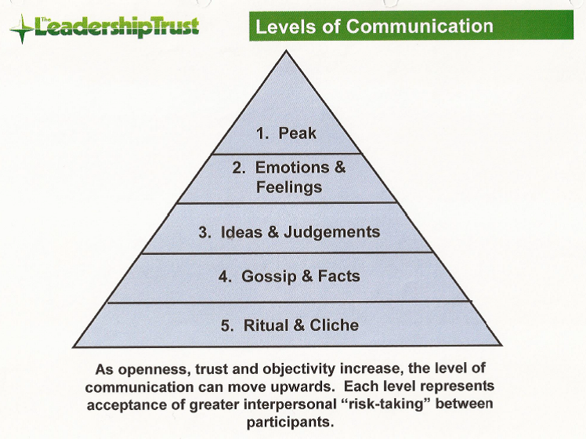

Slide 12
An activity for the team to do
Read the hand outs and reflect…
You should identify the stage of development a team you work in is operating at.

Slide 13
Stage 1
Characteristics of a team that has just started or is working at the lowest level. You;
Don’t deal with the feelings of any members
Restrict being together to just dealing with work
Don’t rock the boat
Don’t listen very well
Don’t have very clear objectives
Don’t feel very involved
Don’t really feel very good about the project
Are happy for somebody else to lead or make decisions

Slide 14
Stage 2
Have you moved on from stage 1 and do you;
Raise ideas and suggest experimentation
Debate risky issues and open up the debate to everybody
Talk about how you are feeling about the project
Express concern for those who may be struggling
Listen to what is said and respond appropriately
Not stop the discussion when it gets uncomfortable?

Slide 15
Stage 3
If you have achieved stage 2 but have you;
Begun to introduce a more methodical approach to your working
Established procedures for the team and members
Agreed on some mutually acceptable ground rules for the team.

Slide 16
Stage 4
As good as it gets......the team and its members operate;
Highly flexibly
Leadership moves around the team as the project develops
You are all putting in maximum effort
You continually review how you operate and adjust as needed
Everybody feels fully involved and valued
You see the project as a development opportunity

Slide 17
So where are you?
Looking at the various stages of development – where is your team?
Thinking about the communication level that you operate at?
Could you get your team to agree on where you are and whether you want to develop?

Slide 18
If you want to develop
You should identify then combine
Your individual strengths and weaknesses
To improve
The internal relationships
The atmosphere in the team
The leadership style you bring to the team

Slide 19
Effective Teams demonstrate
High levels of
Mutual trust
Mutual respect
Mutual support

